Slide 1
Natural Language Processing
Week 7

Slide 2
Good evening, everyone. Welcome to the live session.
Today, we will be practicing problems from the current week’s content.
We will wait 5 minutes for everyone to join in and start at 7:05 pm.

Slide 3
Question 1: Suppose you have a raw text corpus and you compute word co
occurrence matrix from there. Which of the following algorithm(s) can you utilize to
learn word representations? (Choose all that apply)
a. CBOW
b. SVD
c. PCA
d. GloVe

Slide 4
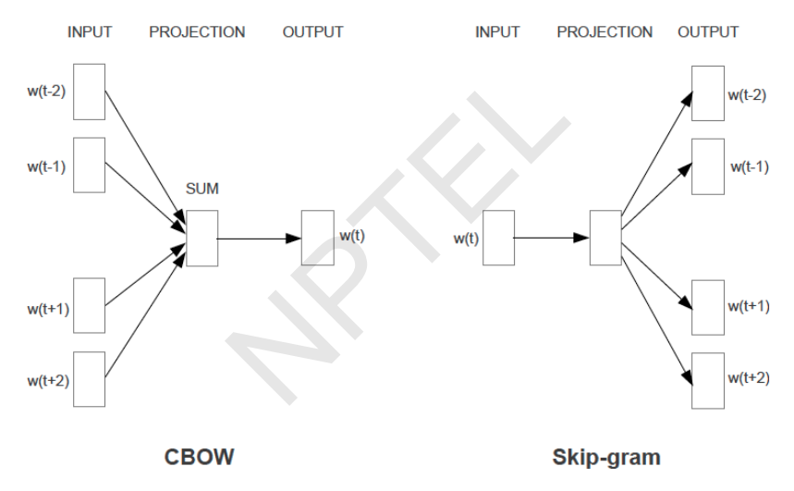
Solution
Answer: a, b, c, d

Slide 5
Question 2: What is the method for solving word analogy questions like, given A, B and D, find C such that A:B::C:D, using word vectors?
a. vc = va + (vb − vd), then use cosine similarity to find the closest word of vc.
b. vc = va + (vd − vb) then do dictionary lookup for vc
c. vc = vd + (vb − va) then use cosine similarity to find the closest word of vc.
d. vc = vd + (va − vb) then do dictionary lookup for vc.
e. None of the above

Slide 6
Solution
Answer: e
Solution: vd − vc = vb − va
vc = vd + va − vb then use cosine similarity to find the closest word of vc.

Slide 7
Question 3: What is the value of PMI(w1, w2) for C(w1) = 100, C(w2) = 2000, C(w1,w2) = 64, N = 100000? N: Total number of documents.
C(wi): Number of documents, wi has appeared in.
C(wi, wj ): Number of documents where both the words have appeared in. Note:
Use base 2 in logarithm.
a. 4
b. 5
c. 6
d. 5.64

Slide 8
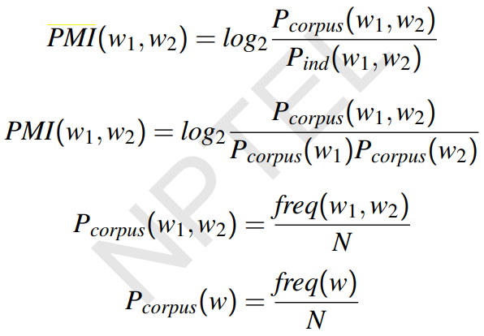
Solution:
P_{corpus}(w1,w2) = 64/100000,
P_{corpus}(w1) = 100/100000, P_{corpus}(w2) = 2000/100000

Slide 9
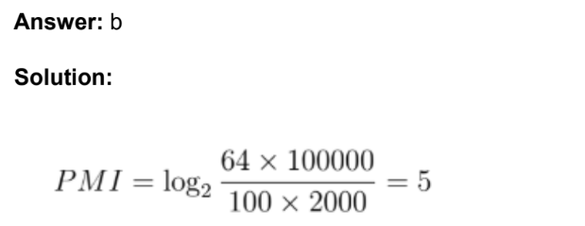
Solution

Slide 10
Question 4: Given two binary word vectors w1 and w2 as follows:
w1 = [1010101010]
w2 = [0011111100]
Compute the Dice and Jaccard similarity between them. [2 marks]
a. 6/11, 3/8
b. 10/11, 5/6
c. 4/9, 2/7
d. 5/9, 5/8

Slide 11
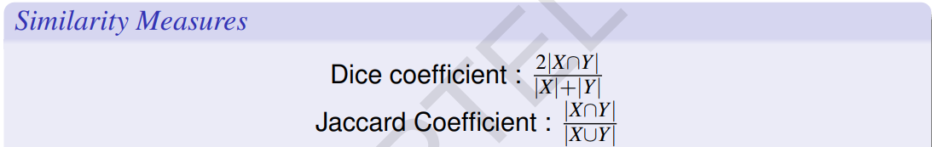
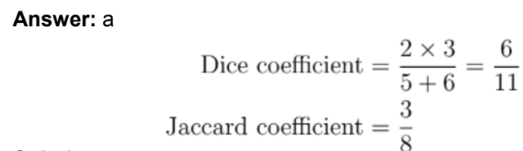
Solution
X = [1010101010]
Y = [0011111100]
X ∩ Y = [0010101000]
|X ∩ Y| = 3, |X| = 5, |Y| = 6
X ∪ Y = [1011111110],|X ∪ Y| = 8

Slide 12
Question 5: Consider two probability distributions for two words be p and q. Compute their similarity scores with KL-divergence. [2mark]
p = [0.20, 0.75,0.50]
q = [0.90, 0.10, 0.25]
Note: Use base 2 in logarithm.
a. 4.704, 1,720
b. 1.692, 0.553
c. 2.246, 1.412
d. 3.213, 2.426

Slide 13
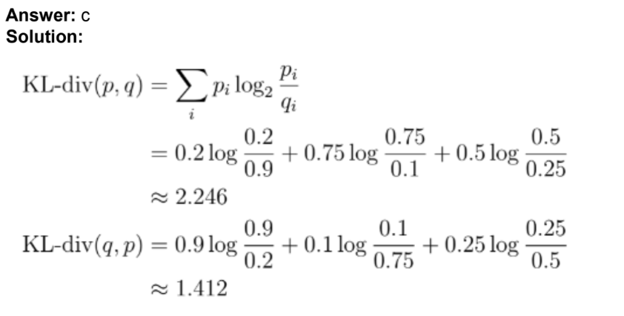
Solution
p = [0.20, 0.75,0.50], q = [0.90, 0.10, 0.25]

Slide 14
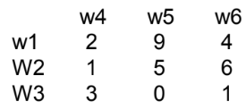
Question 6: Consider the following word co-occurrence matrix given below. Compute the cosine similarity between (i) w1 and w2, and (ii) w1 and w3. [2 mark]
a. 0.773, 0.412
b. 0.881, 0.764
c. 0.665, 0.601
d. 0.897, 0.315

Slide 15
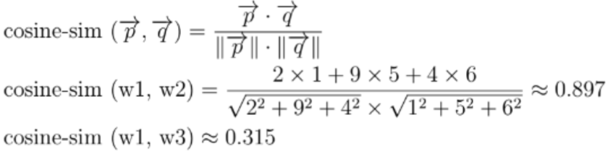
Solution
Answer: d
Solution:
w1 = [2,9,4], w2 = [1,5,6], w3 = [3,0,1]

